Slide 1
The IOT Smart
Lock Project
MID-TERM EVALUATION
Presented by :
Nadeem Totad-1MS18CS080
Praharsh B. -1MS18CS090
Sammed Kamate-1MS18CS106
Siddarth Bhave-1MS18CS121
Subject : engineering design
Subject code :al21
Guided by : shilpa hariraj

Slide 2
Index :
About the project
Instruments Used
Circuit Diagrams
Advantages

Slide 3
About The Project :
We could connect our Arduino to any network by adding HC-50 Bluetooth Module
The HC-50 Bluetooth module is a complete Bluetooth network where you can easily connect as a serving bluetooth adapter, wireless internet access interface to any microcontroller­ based design on its simple connectivity through Serial Communication or UART interface.
By connecting this module to a servo motor in return we could easily achieve our aim that is to provide complete IoT to any platform in any institution .
This could easily be reproduced and extended to a lot more advanced level and achieve complete home automation in a single go.

Slide 4
Software and Hardware Components:
Arduino Uno
Bread Board
HC-50 Bluetooth Module
Tower Pro SG90 9g micro Servo motor
Jumper Junctions
Embedded C

Slide 5
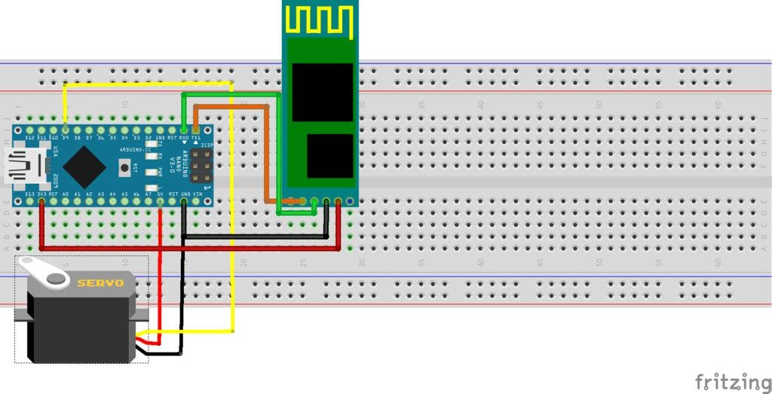
Circuit Representation:
Bread Board
Arduino
HC-50
Bluetooth module
Servo Motor

Slide 6
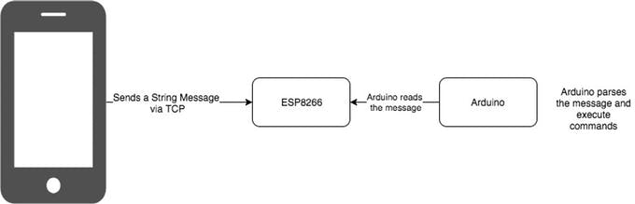
Block Diagram:
Mobile Phone
Arduino reads
the message
Sends a String via Serial Monitor
HC-50
Bluetooth module
Arduino passes the message and executes the command
Fig : Block Diagram of working

Slide 7
Advantages :
Unique lockset that is very attractive to the IT department and security teams
Very cost effective way for general contractors to build security in by reducing the number of subs needed for installation
Single package makes commissioning and troubleshooting dramatically faster and easier so less of a project management hassle for door security components
Paired with the total IoT home solution version it makes for a solution set for a broad range of doors

Slide 8
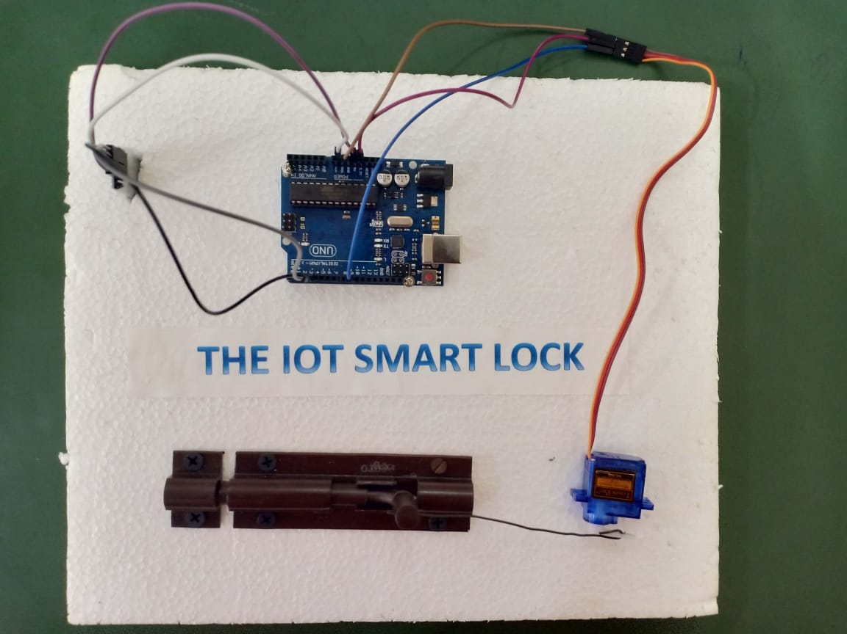
Screenshot of the Model
Jumper wires
Bluetooth module
Arduino board
The whole circuit with fabrication
Lock
Servo motor

Slide 9
Working
We first start the working by powering the Arduino board using a USB power supply through a computer or by an external power source. The Bluetooth module turns on and it needs to be paired with a phone. It is protected by a password which could be changed using a AT command terminal. After pairing up, the phone should be downloaded with a Bluetooth terminal for the communication with the module. We used Bluetooth Terminal, developed by Qwerty developers. Now connect the same with module with the terminal too. The Bluetooth module is named HC-05.
After connecting it with the module, if we give 0 as input to the terminal the servo motor locks the door and when given 1 it unlocks the same. This lock needs to be connected to a constant power supply to the Bluetooth module running. After you are done with it you could unpair with your phone and we you want to use the lock again you have to enter the password and command it open or close.

Slide 10
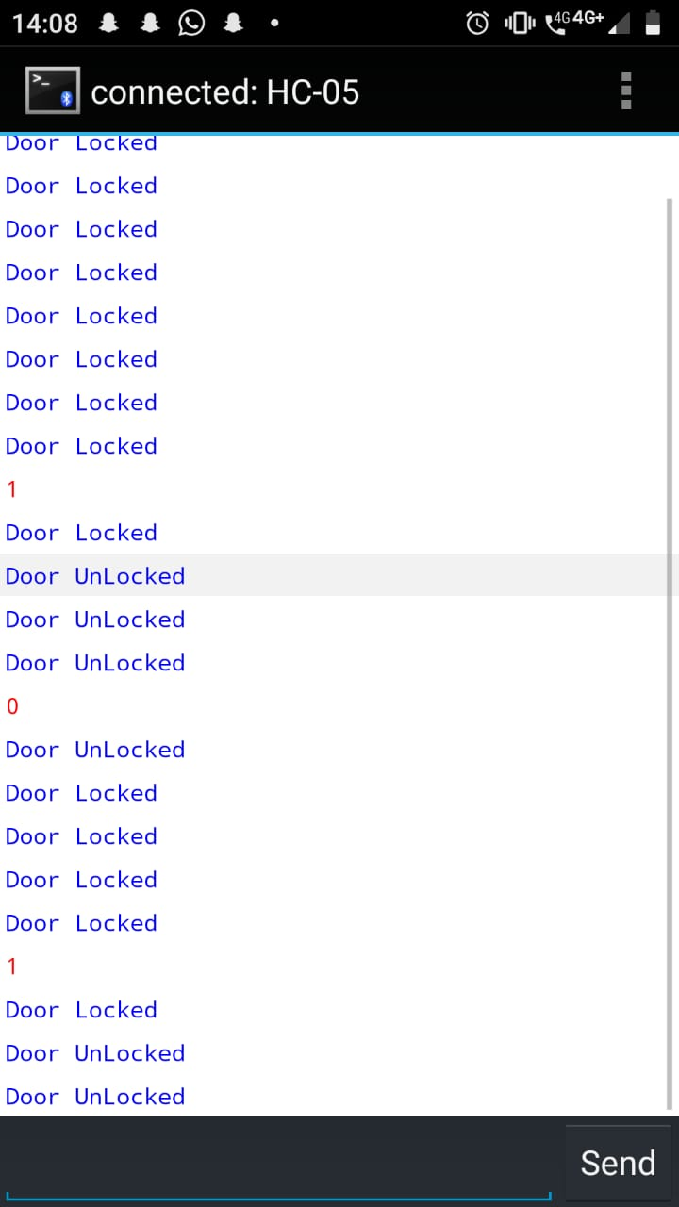
Screenshot of the working(Serial Window)
Phone screen simulated as a serial monitor

